Slide 1

IMPACT OF COVID-19
ON US MARKET based on sector
Presented by - GROUP H
Notes:
To use this title animation slide with a new image simply 1) move the top semi-transparent shape to the side, 2) delete placeholder image, 3) click on the picture icon to add a new picture, 4) Move semi-transparent shape back to original position, 5) Update text on slide.

Slide 2
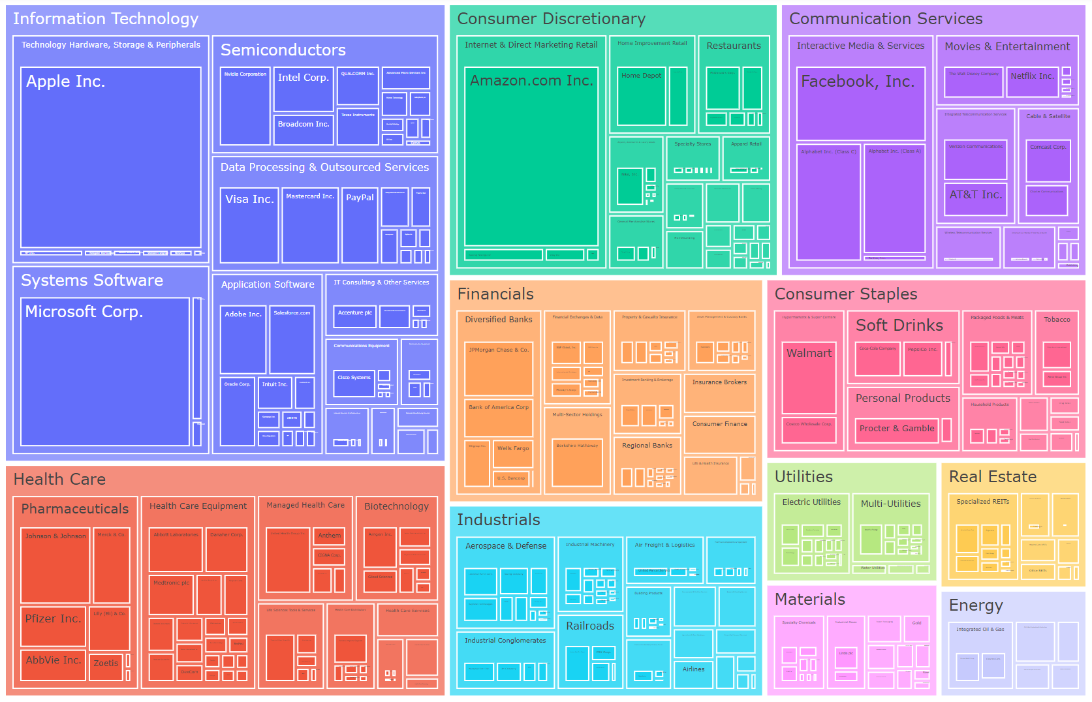
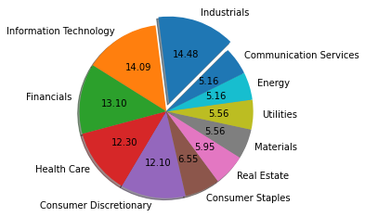
S&P 500 is a market-capitalization-weighted index of the 500 largest U.S. publicly traded companies.

Slide 3
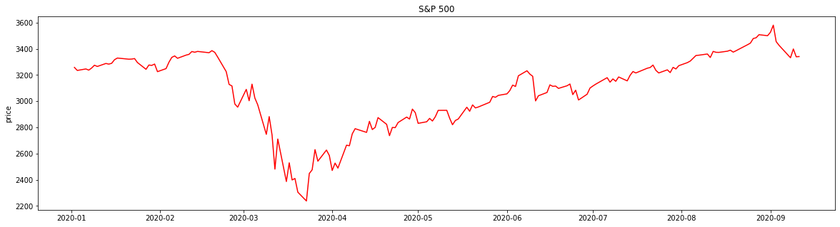



Overview of COVID-19 Pandemic on S&P500
Global & U.S. stock market crashed since 23rd March due to COVID-19 pandemic.
We have reached the middle stage of pandemic, where many industries start to recover and gain back investor trust
Which industries is getting more favoured by investor?
What does the quarterly trend performance of S&P500 show us?

Slide 4
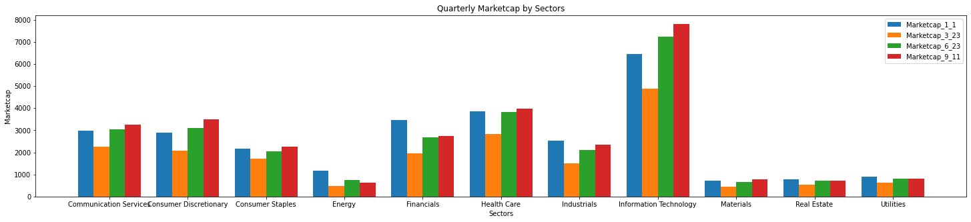
Performance of Market Cap by Sector
Market Cap has generally recovered back to pre-pandemic level for most sectors.
Information Technology, Health Care, Consumer Discretionary and Communication Services Sector have recovered promptly.
Energy Sector, Utilities and Real Estate Sector remains low in performance

Slide 5
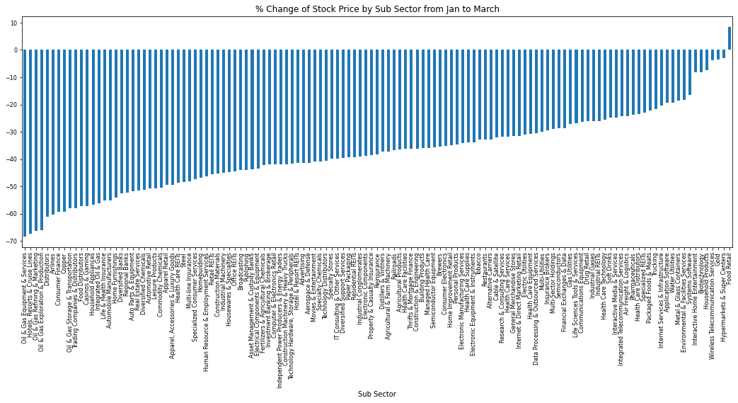
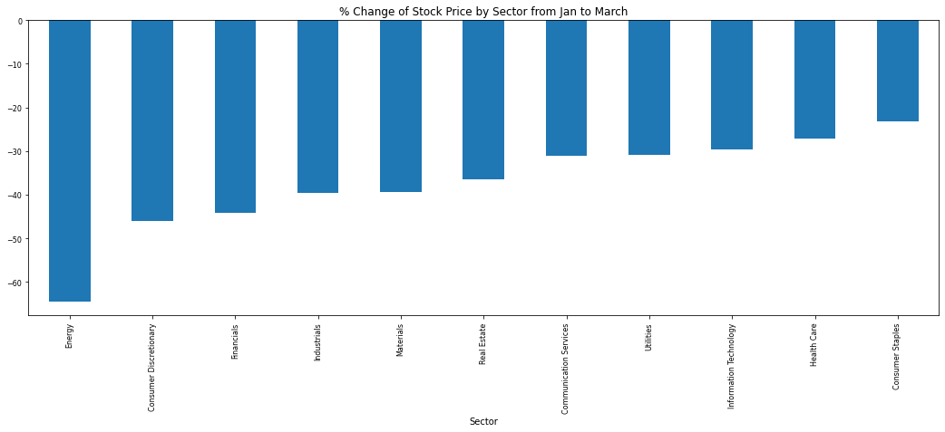
2020 Q1 Performance of Stock Price by Sub-Sector

Slide 6
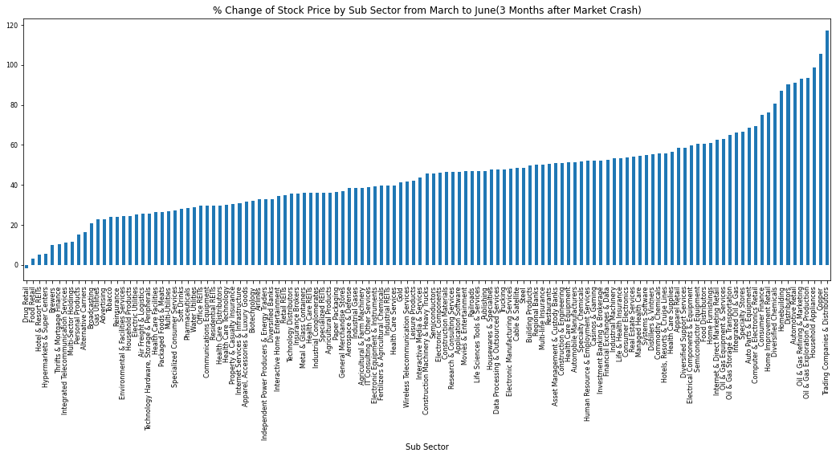
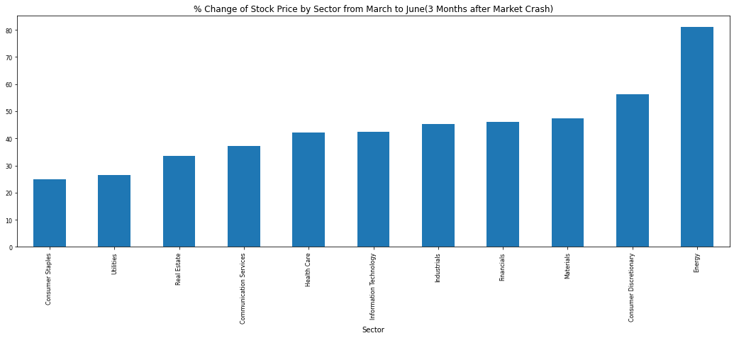
2020 Q2 Performance of Stock Price by Sub-Sector

Slide 7
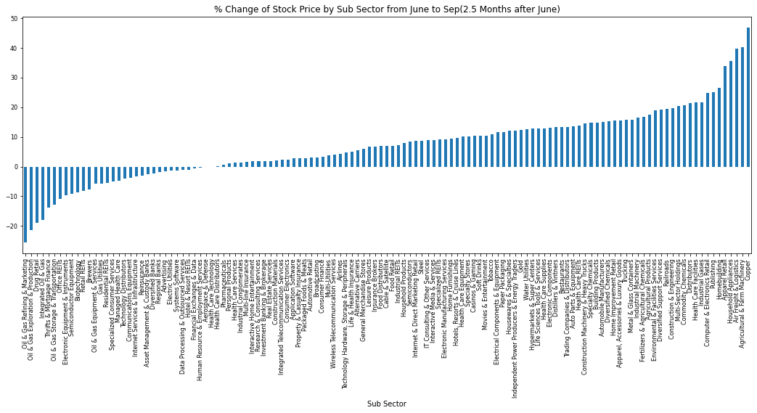
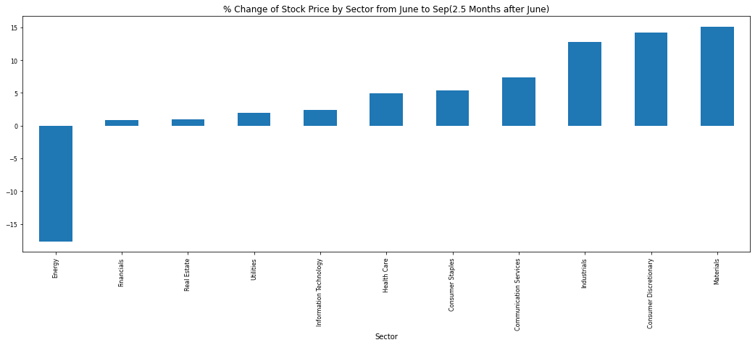
2020 Q3 Performance of Stock Price by Sub-Sector

Slide 8

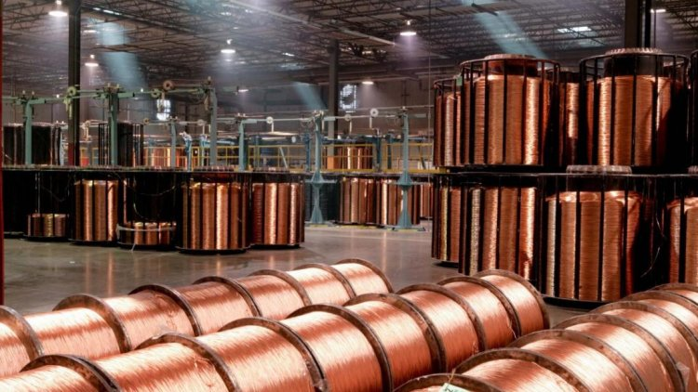
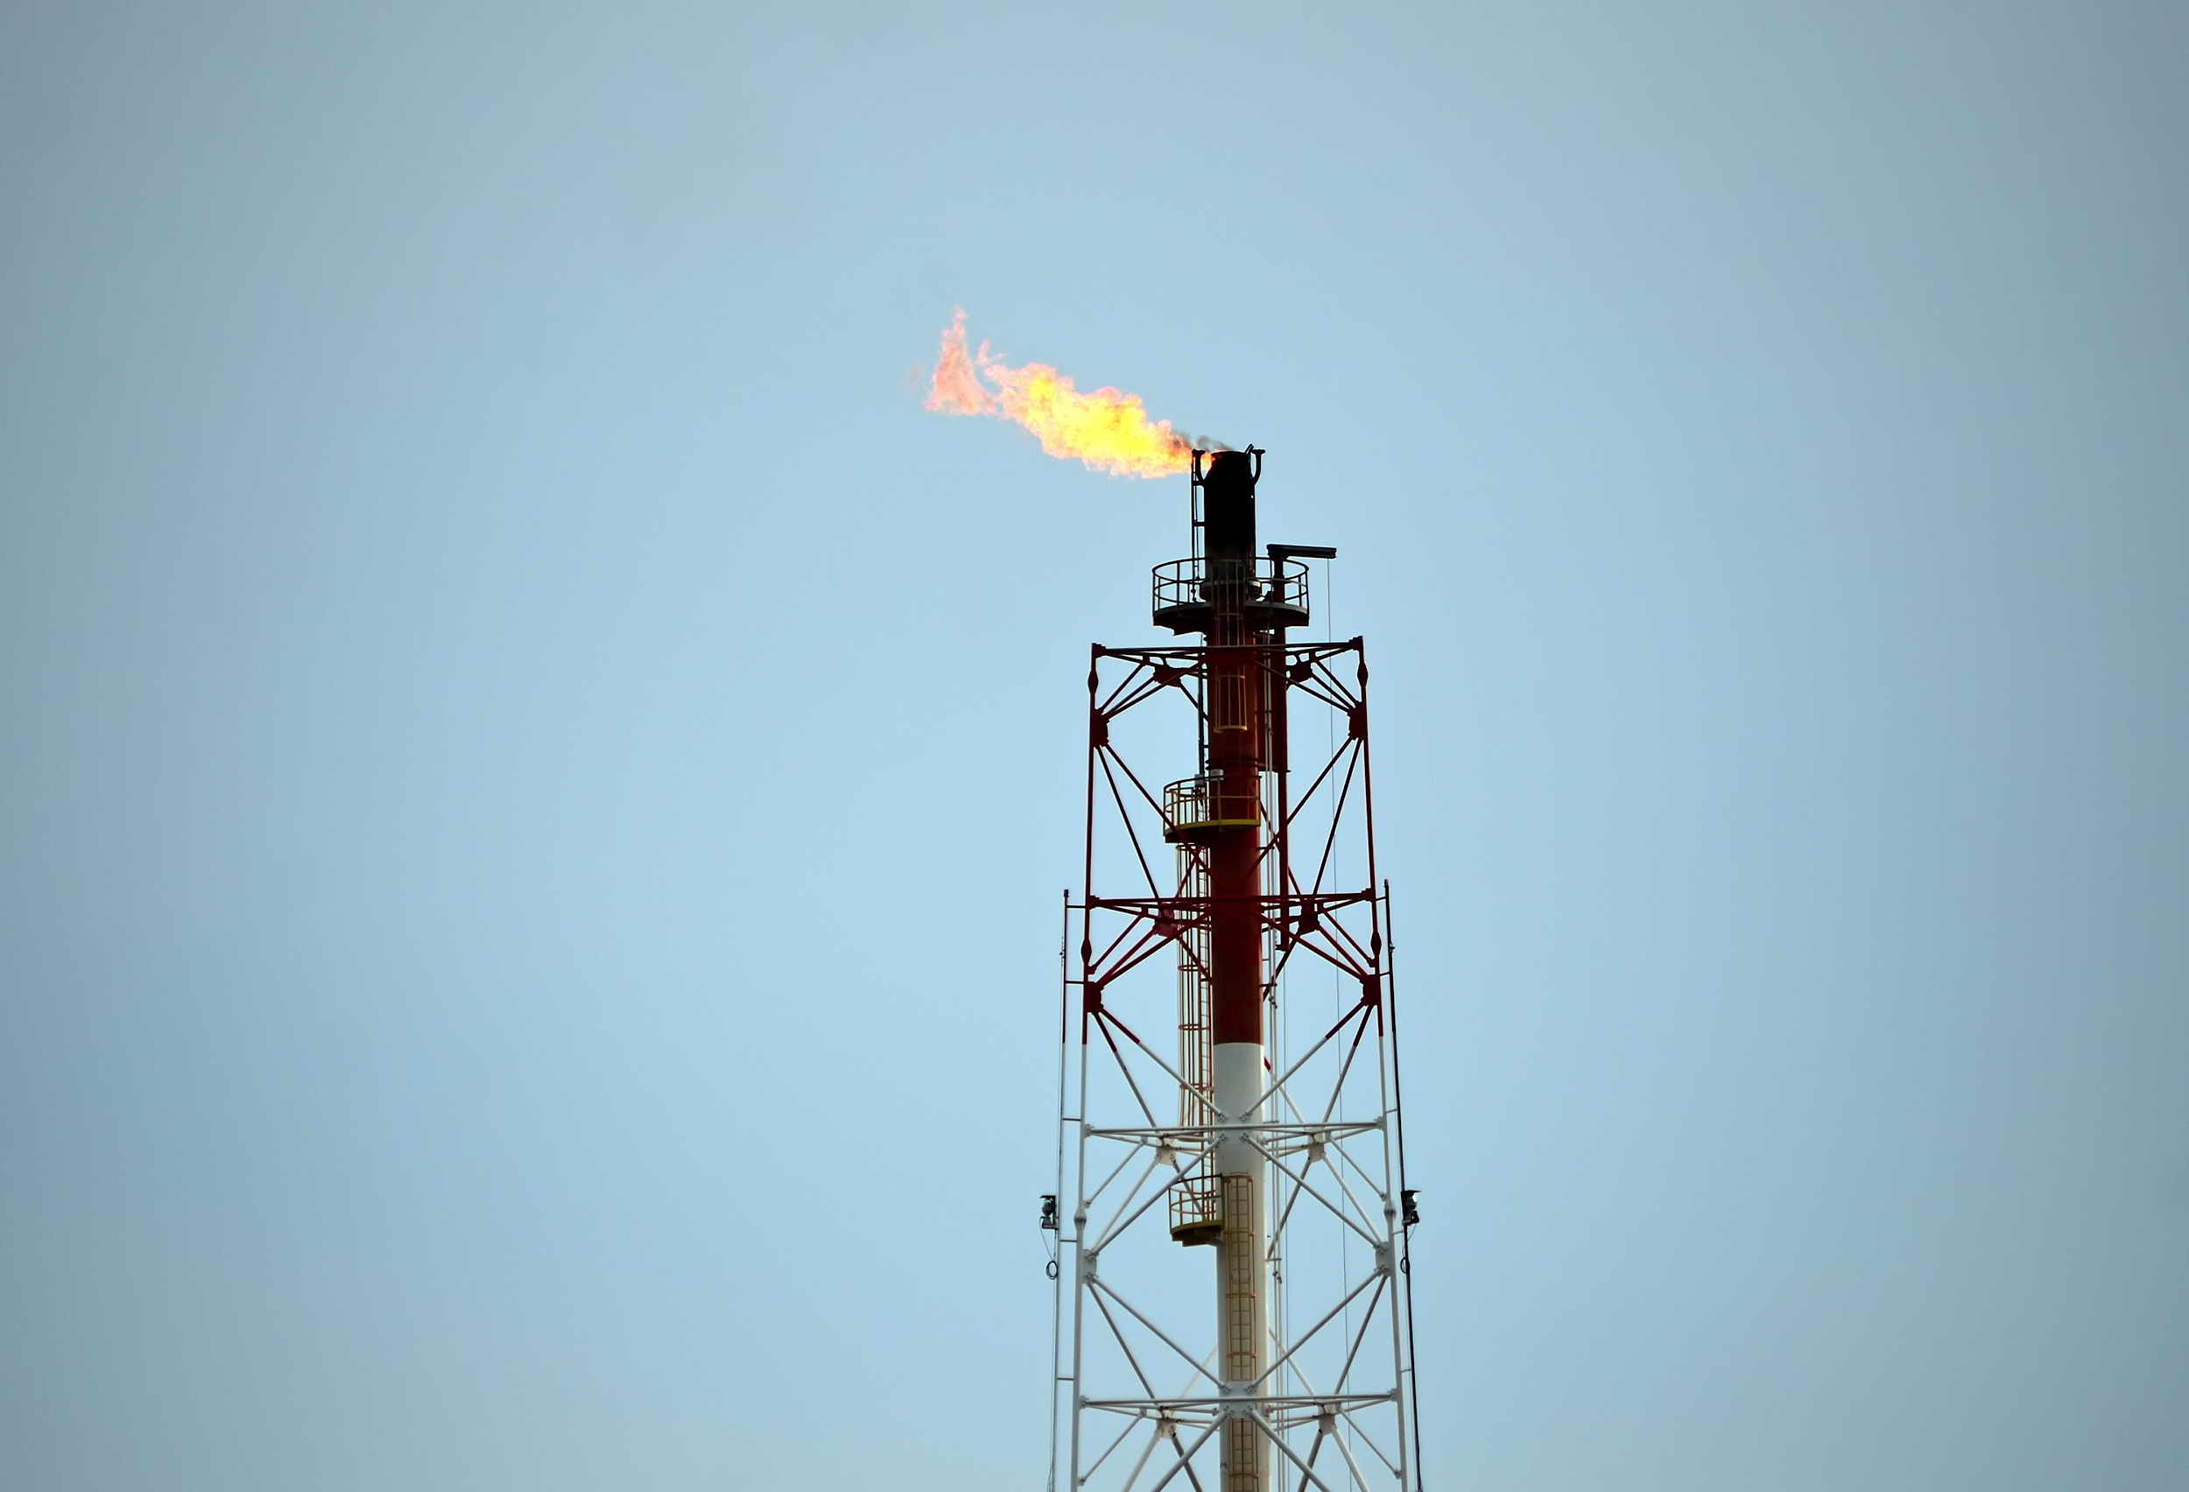
Breakdown of Sub-Sector shows Deeper Insights:
High Volatility within Sub-Sectors within the Energy Sector
Rising Performance in Material Sector
Copper sector’s price rises steadily 110% & continues rally by 50% across March to June & June to Sept.

Slide 9
Thank you

